Slide 1
Emission Factor calculation

Slide 2
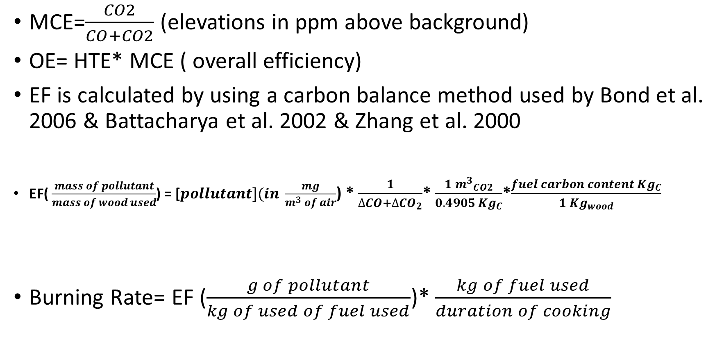
Essential Formulas
MCE=$\frac{CO2}{CO+CO2}$ (elevations in ppm above background)
OE= HTE* MCE ( overall efficiency)
EF is calculated by using a carbon balance method used by Bond et al. 2006 & Battacharya et al. 2002 & Zhang et al. 2000
EF( $\frac{mass of pollutant}{mass of wood used}$) = [$pollutant](in \frac{mg}{m^{3} of air}$) * $\frac{1}{∆CO+∆{CO}_{2}}$* $\frac{{{1 m}^{3}}_{CO2}}{{0.4905 Kg}_{C}}$*$\frac{{fuel carbon content Kg}_{C}}{{1 Kg}_{wood}}$
Burning Rate= EF ($\frac{g of pollutant}{kg of used of fuel used}$)* $\frac{kg of fuel used}{duration of cooking}$
Notes:
(Gyapa, Phillips and Three-stones)

Slide 3
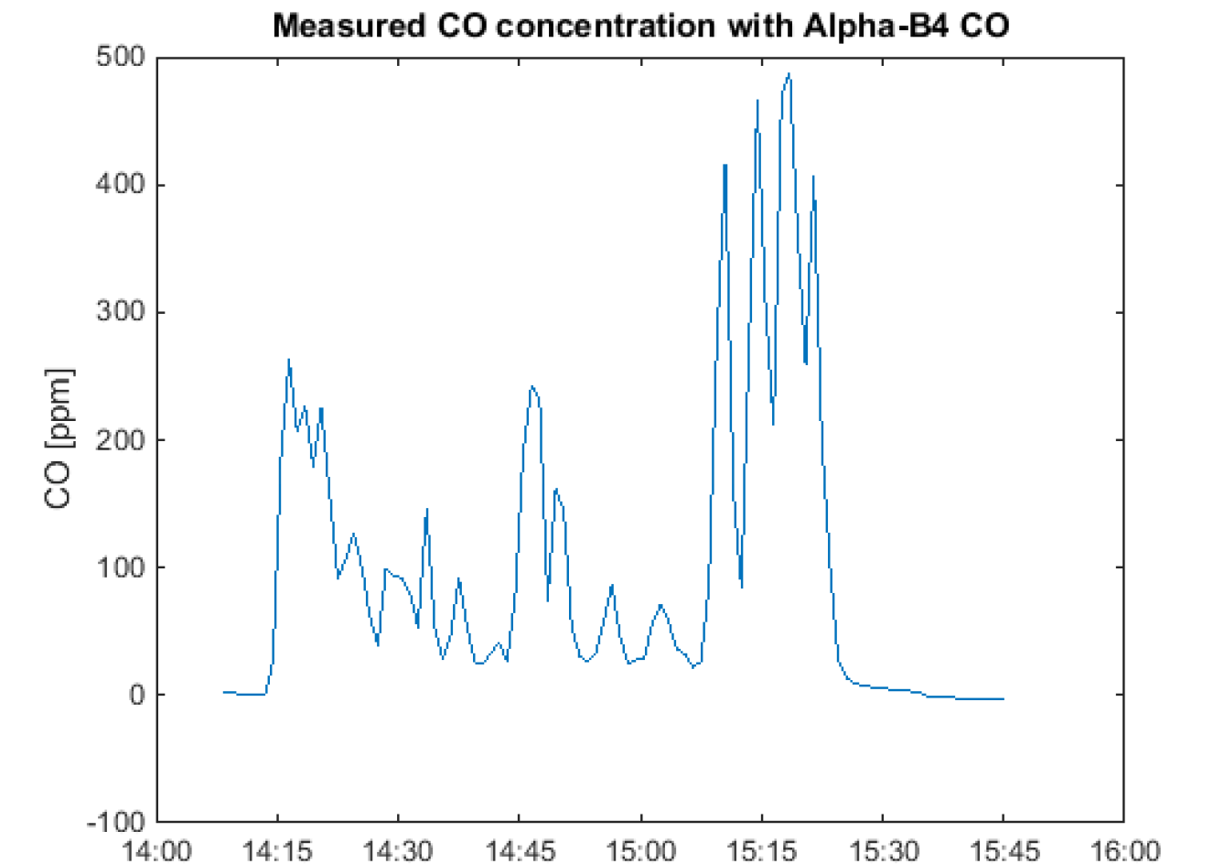
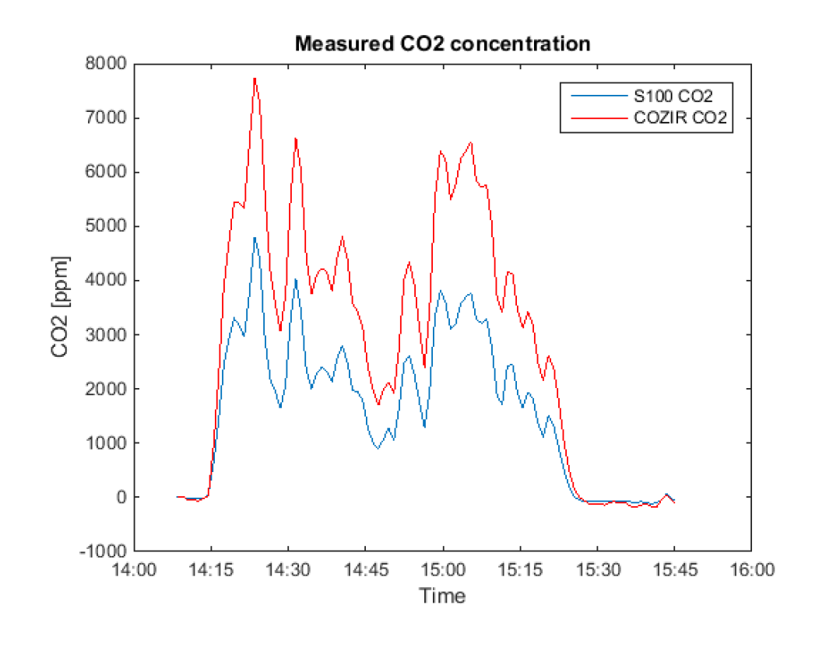
Time series of CO and CO2 on January 8th 2015
Mean, background corrected [CO2] = 2132 ppm
Mean, background corrected [CO] = 112 ppm

Slide 4


Conversion from [ppm] to mass concentration
With ideal gas law
$P∗V=n∗R∗T=\frac{m}{MW}∗R∗T$
$\left[\frac{m}{V}\right]$ = $\frac{P∗MW }{R∗T}$
Avg [CO] = 112 ppm (from pod)
Avg [CO2] = 2132 ppm (from pod)
Avg T = 34.20C (from pod) or 307.35 K
Avg P = 992.985 millibar (from pod) or 0.98 atm
MW = 28 $\frac{g}{mol}$ for CO and 44 $\frac{g}{mol}$for CO2
R = 0.08206 $\frac{L. atm}{mol.K}$
CO_{mass concentration} = $\frac{0.98 atm ×28 \frac{g}{mol} × 112×{10}^{−6}× \frac{{10}^{3}L}{{1m}^{3}} × \frac{{10}^{3}mg}{g}}{0.08206 \frac{L.atm}{mol. K } × 307.35K}$ = $\frac{122 mg}{m^{3}}$ of CO

Slide 5
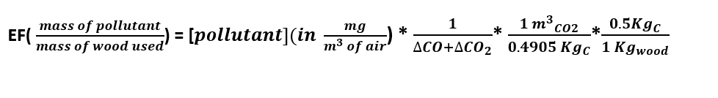
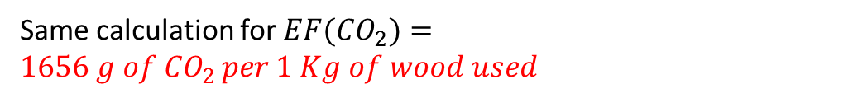
EF calculation example (for wood)
EF (CO) = $\frac{122 mg of CO}{m^{3} of air }$* $\frac{ L of air}{\left(112 +2132\right)µL}×\frac{m^{3}of air}{{10}^{3}L air}∗\frac{{10}^{9}µL }{{kg}_{wood}}$*$\frac{0.5}{0.4905}∗\frac{{10}^{−3}g}{1 mg}=56 \frac{g of CO}{1 kg of wood}$
Same calculation for ${EF(CO}_{2})=1656 g of {CO}_{2 }per 1 Kg of wood used$
Use different carbon fuel contents for different fuels (e.g. charcoal ~0.72)

